Slide 1
Predictive Analysis for Decision Making
Weeks 7 and 8
Modelling Time Series Models
Dr Issam Malki
School of Finance and Accounting
Westminster Business School
March 2022

Slide 2
Part I: Notation and Concepts

Slide 3
Aims and Objectives
Most of the models deal with cross sections
Variables can be time dependent and observed over time for the same entity.
Time series models
In genera, we follow the same modelling strategies
Prominent issues related to time: serial correlation and time varying variance.
Introduce Time Series Models
Modelling long run and short run relations
Dealing with stationary data
Extension to account for nonstationary components.

Slide 4
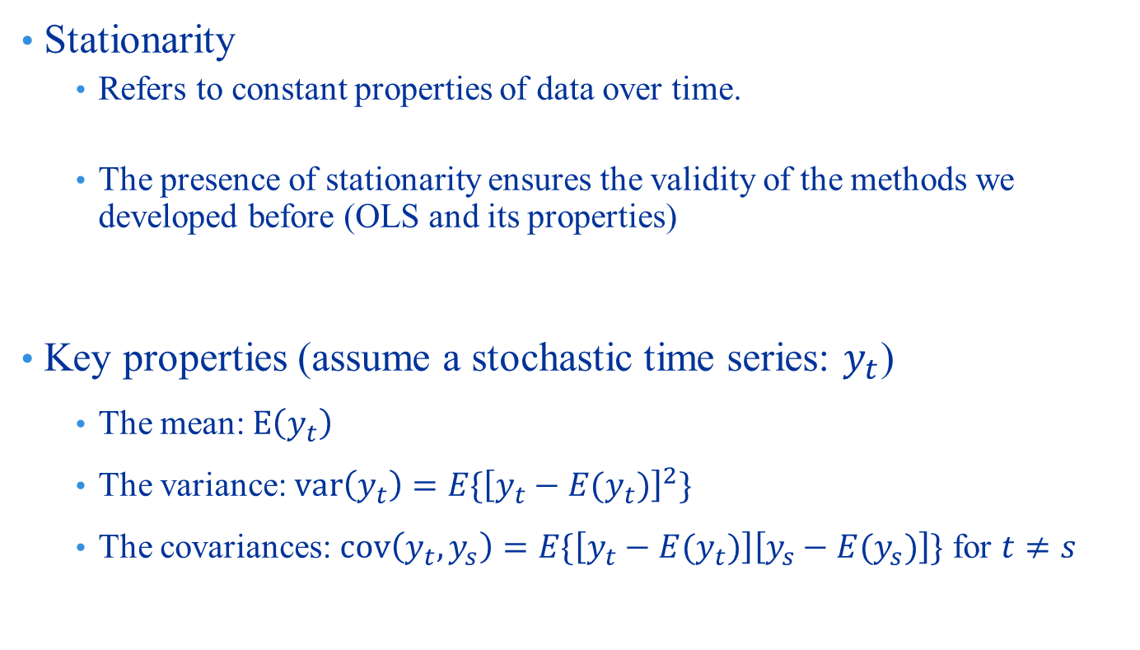
Time Series and Concept of Stationarity
Stationarity
Refers to constant properties of data over time.
The presence of stationarity ensures the validity of the methods we developed before (OLS and its properties)
Key properties (assume a stochastic time series: $y_{t}$)
The mean: $E\left(y_{t}\right)$
The variance: $var\left(y_{t}\right)=E\{{\left[y_{t}−E(y_{t})\right]}^{2}\}$
The covariances: $cov\left(y_{t},y_{s}\right)=E\{\left[y_{t}−E(y_{t})\right]\left[y_{s}−E(y_{s})\right]\}$ for $t≠s$

Slide 5
Time Series and Concept of Stationarity

Slide 6
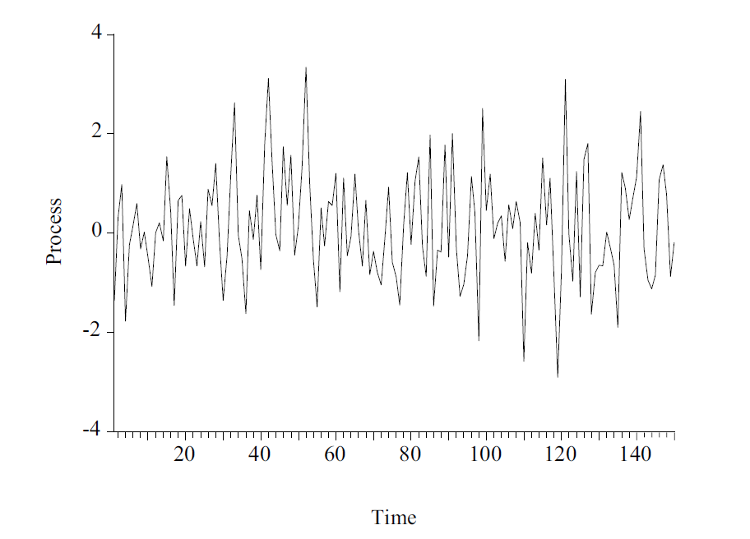
Time Series and Concept of Stationarity

Slide 7
Time Series and Concept of Stationarity

Slide 8
Time Series and Concept of Stationarity

Slide 9
Time Series and Concept of Stationarity

Slide 10
Time Series and Concept of Stationarity
Strictly Stationary Process
Rarely seen in applications of finance
Covariance (weakly) stationary
Commonly used process: the following must be satisfied
1. E(y_{t}) = μ , t = 1,2,...,∞
2.
3. for any t₁ , t₂
Others include
Trend stationary process
Cyclical and seasonal processes

Slide 11
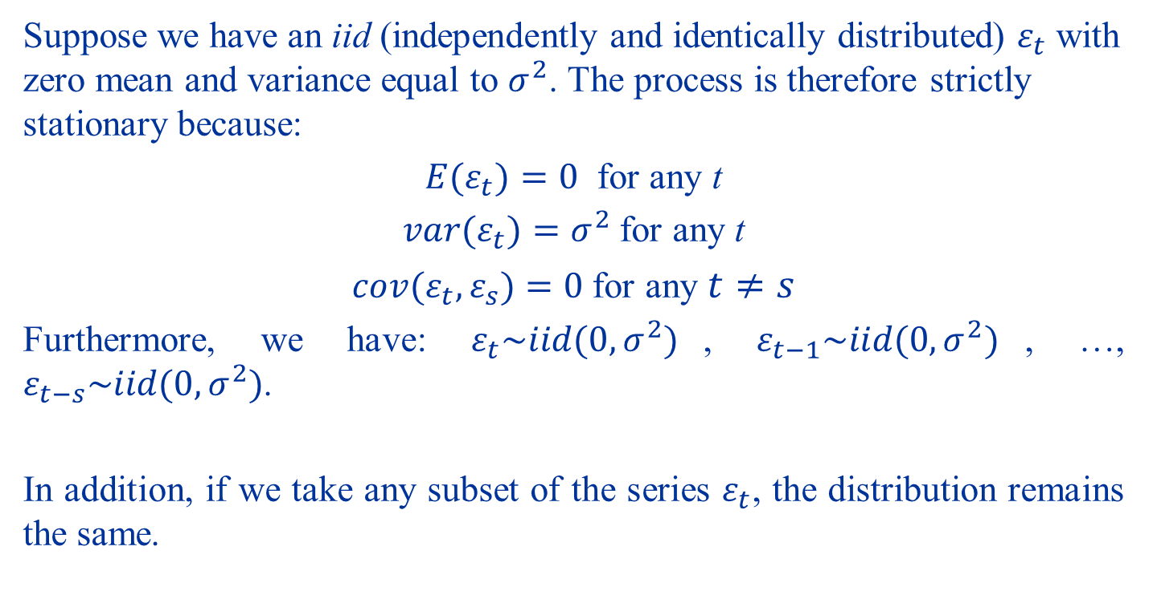
Examples (1)
Suppose we have an iid (independently and identically distributed) $ε_{t}$ with zero mean and variance equal to $σ^{2}$. The process is therefore strictly stationary because:
${E(ε}_{t})=0$ for any t
${var(ε}_{t})=σ^{2}$ for any t
${cov(ε}_{t},ε_{s})=0$ for any $t≠s$
Furthermore, we have: $ε_{t}\sim iid(0,σ^{2})$, $ε_{t−1}\sim iid(0,σ^{2})$, …, $ε_{t−s}\sim iid(0,σ^{2})$.
In addition, if we take any subset of the series $ε_{t}$, the distribution remains the same.

Slide 12
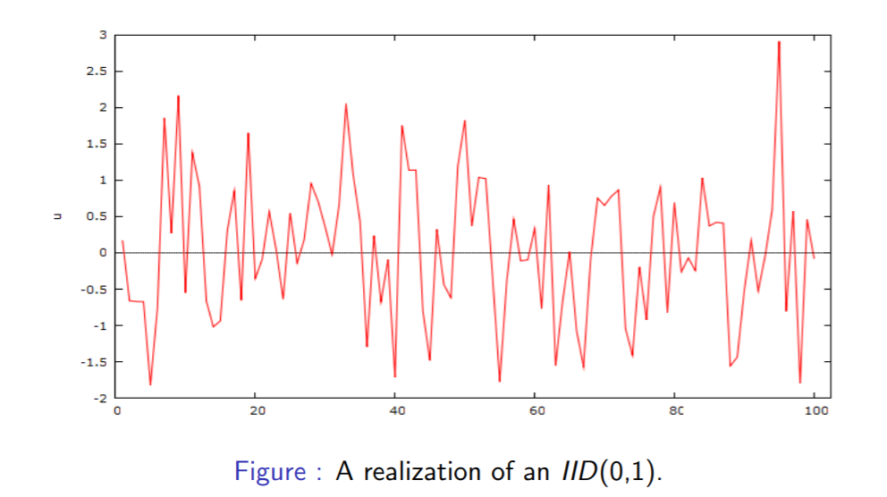
Examples (1)

Slide 13
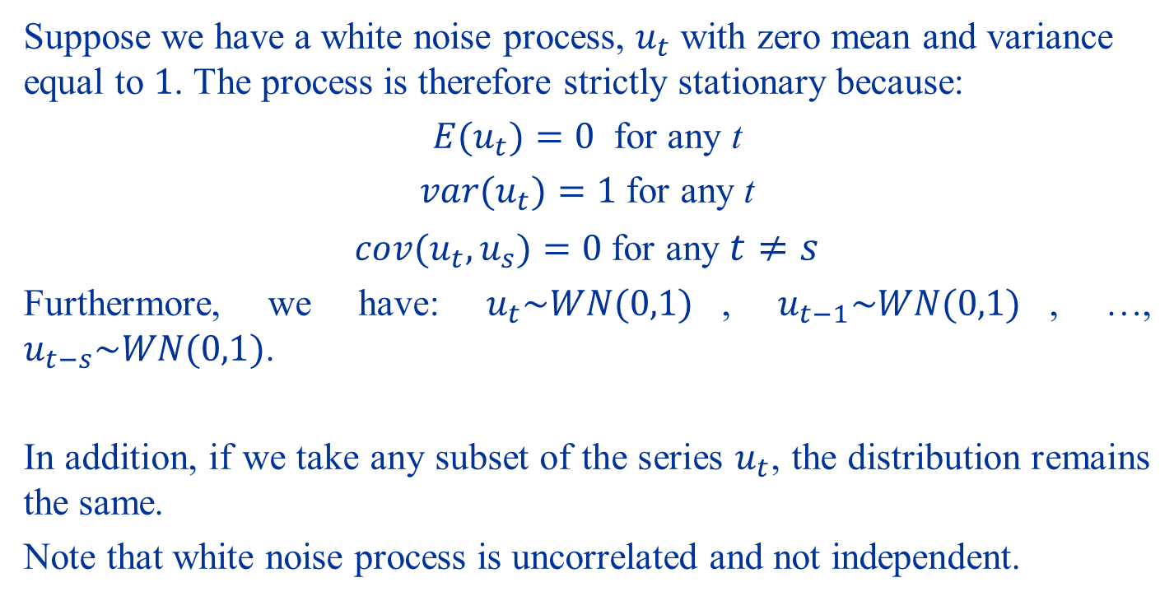
Examples (2)
Suppose we have a white noise process, $u_{t}$ with zero mean and variance equal to $1$. The process is therefore strictly stationary because:
${E(u}_{t})=0$ for any t
${var(u}_{t})=1$ for any t
${cov(u}_{t},u_{s})=0$ for any $t≠s$
Furthermore, we have: $u_{t}\sim WN(0,1)$, $u_{t−1}\sim WN(0,1)$, …, $u_{t−s}\sim WN(0,1)$.
In addition, if we take any subset of the series $u_{t}$, the distribution remains the same.
Note that white noise process is uncorrelated and not independent.

Slide 14
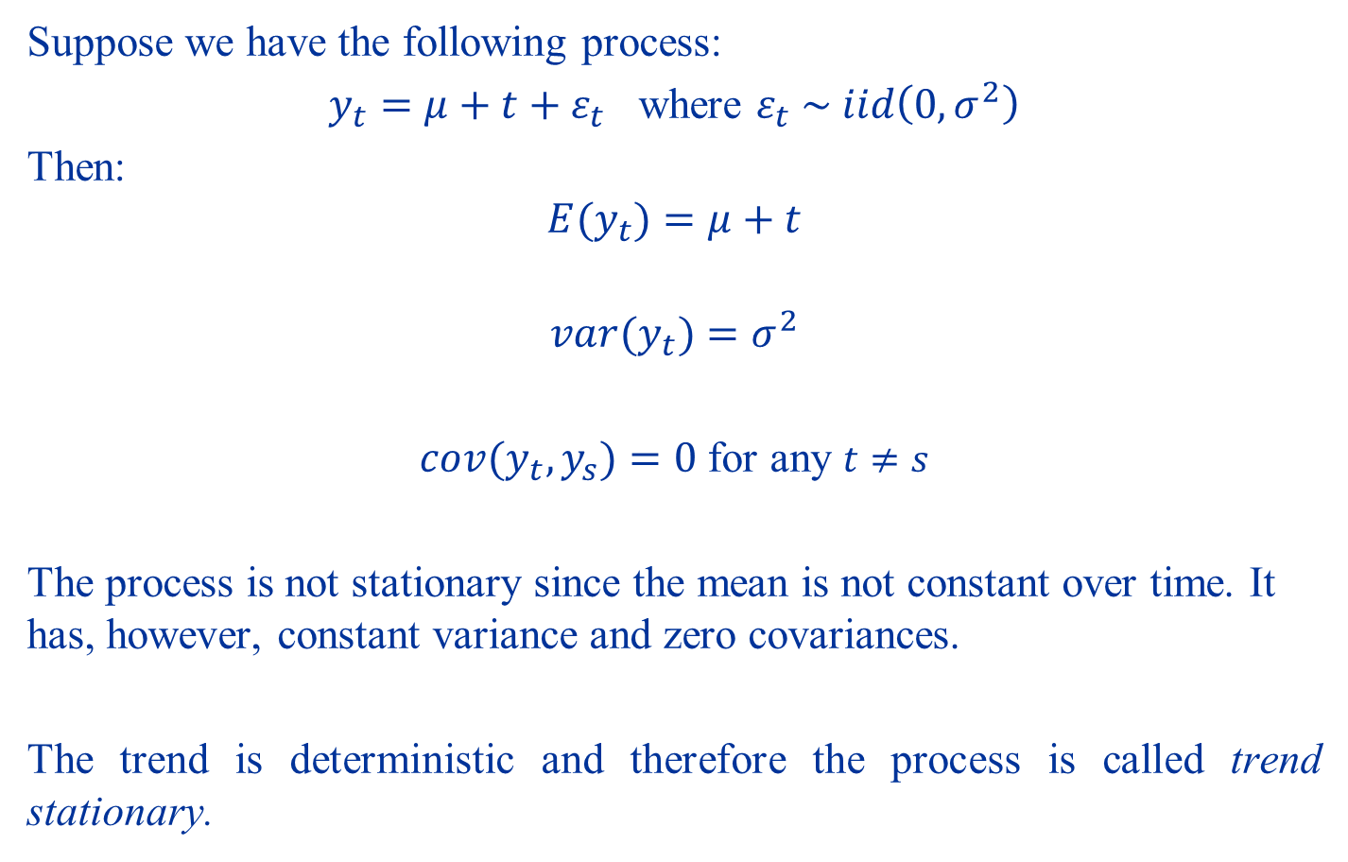
Examples (3)
Suppose we have the following process:
$y_{t}=μ+t+ε_{t}$ where $ε_{t} \sim iid\left(0,σ^{2}\right)$
Then:
$$E(y_{t})=μ+t$$
$$var(y_{t})=σ^{2}$$
$cov(y_{t},y_{s})=0$ for any $t≠s$
The process is not stationary since the mean is not constant over time. It has, however, constant variance and zero covariances.
The trend is deterministic and therefore the process is called trend stationary.

Slide 15
Examples (3)

Slide 16
Examples (3)

Slide 17
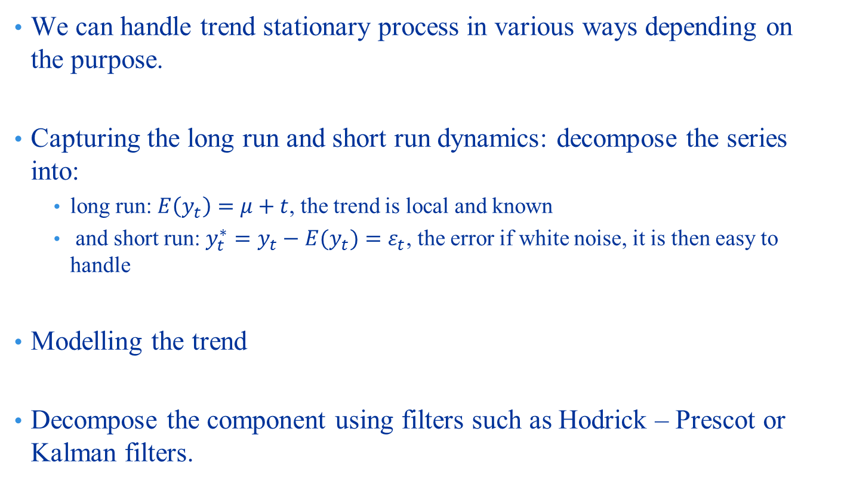
Examples (3)
We can handle trend stationary process in various ways depending on the purpose.
Capturing the long run and short run dynamics: decompose the series into:
long run: $E\left(y_{t}\right)=μ+t$, the trend is local and known
and short run: $y_{t}^{∗}=y_{t}−E(y_{t})=ε_{t}$, the error if white noise, it is then easy to handle
Modelling the trend
Decompose the component using filters such as Hodrick – Prescot or Kalman filters.

Slide 18
Examples (3)

Slide 19
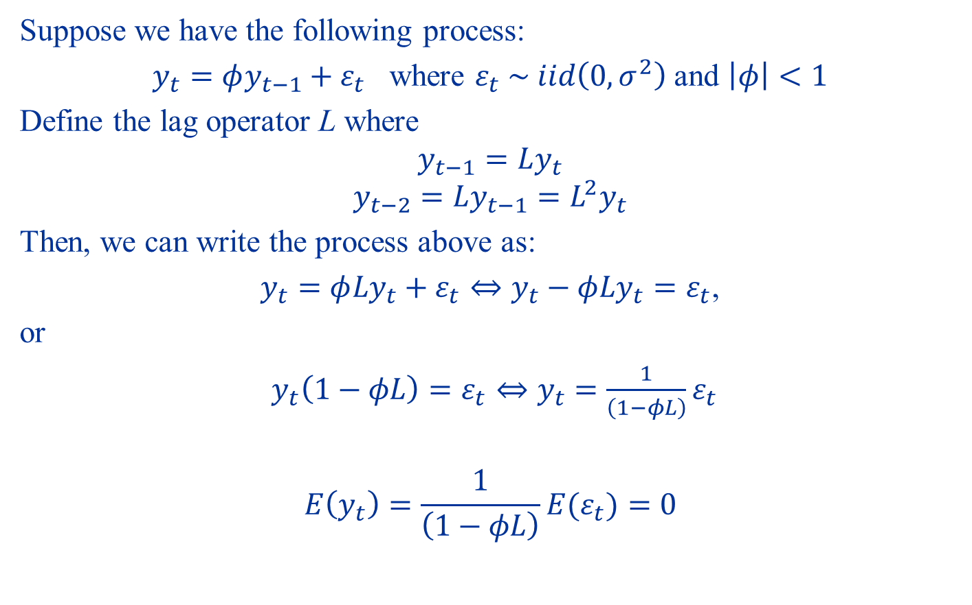
Examples (4)
Suppose we have the following process:
$y_{t}=φy_{t−1}+ε_{t}$ where $ε_{t} \sim iid\left(0,σ^{2}\right)$ and $\left|φ\right|<1$
Define the lag operator L where
$$y_{t−1}=Ly_{t}$$
$$y_{t−2}={Ly_{t−1}=L}^{2}y_{t}$$
Then, we can write the process above as:
$y_{t}=φ{Ly}_{t}+ε_{t}⇔y_{t}−φ{Ly}_{t}=ε_{t}$,
or
$y_{t}\left(1−φL\right)=ε_{t}⇔y_{t}=\frac{1}{\left(1−φL\right)}ε_{t}$
$$E\left(y_{t}\right)=\frac{1}{\left(1−φL\right)}{E(ε}_{t})=0$$

Slide 20
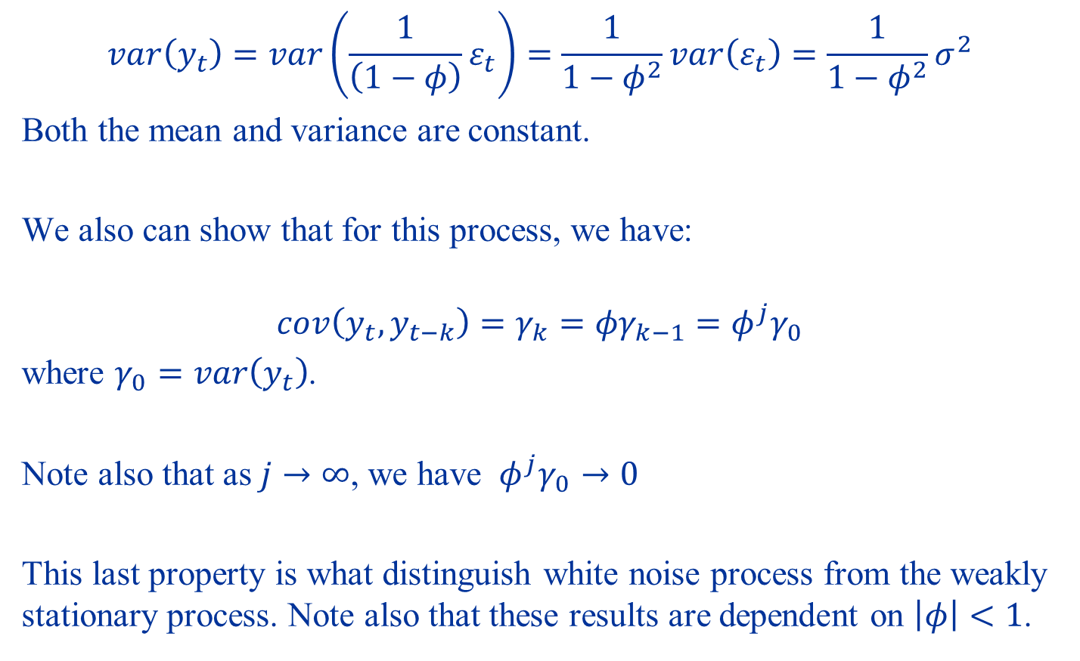
Examples (4)
$$var\left(y_{t}\right)=var\left(\frac{1}{\left(1−φ\right)}ε_{t}\right)=\frac{1}{{1−φ}^{2}}var\left(ε_{t}\right)=\frac{1}{{1−φ}^{2}}σ^{2}$$
Both the mean and variance are constant.
We also can show that for this process, we have:
$$cov\left(y_{t},y_{t−k}\right)=γ_{k}={φγ}_{k−1}=φ^{j}γ_{0}$$
where $γ_{0}=var\left(y_{t}\right)$.
Note also that as $j→∞$, we have ${ φ}^{j}γ_{0}→0$
This last property is what distinguish white noise process from the weakly stationary process. Note also that these results are dependent on $\left|φ\right|<1$.

Slide 21
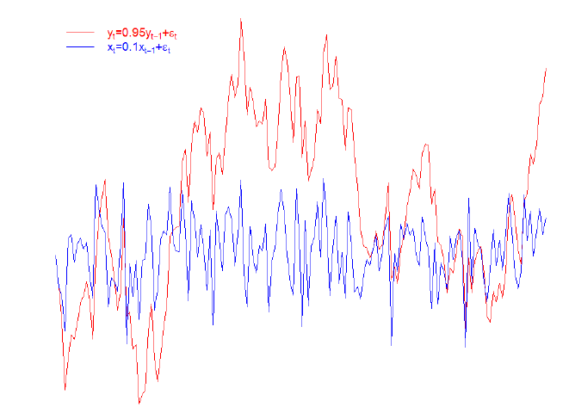
Examples (4)

Slide 22
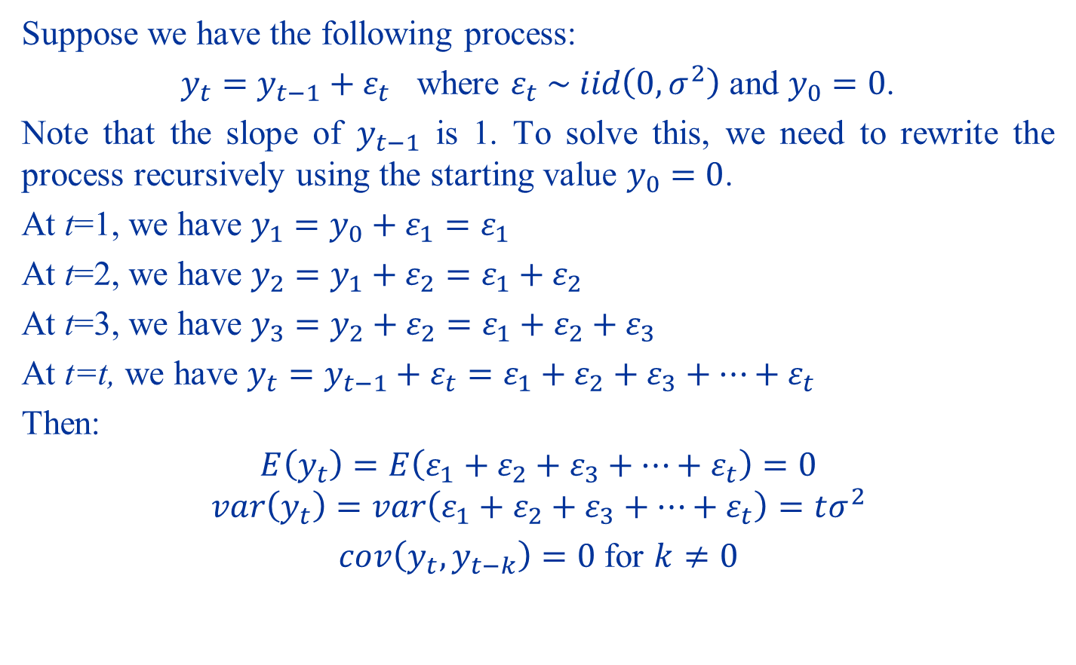
Examples (5)
Suppose we have the following process:
$y_{t}=y_{t−1}+ε_{t}$ where $ε_{t} \sim iid\left(0,σ^{2}\right)$ and $y_{0}=0$.
Note that the slope of $y_{t−1}$ is 1. To solve this, we need to rewrite the process recursively using the starting value $y_{0}=0$.
At t=1, we have $y_{1}=y_{0}+ε_{1}=ε_{1}$
At t=2, we have $y_{2}=y_{1}+ε_{2}=ε_{1}+ε_{2}$
At t=3, we have $y_{3}=y_{2}+ε_{2}=ε_{1}+ε_{2}+ε_{3}$
At t=t, we have $y_{t}=y_{t−1}+ε_{t}=ε_{1}+ε_{2}+ε_{3}+…+ε_{t}$
Then:
$$E\left(y_{t}\right)=E\left(ε_{1}+ε_{2}+ε_{3}+…+ε_{t}\right)=0$$
$$var\left(y_{t}\right)=var\left(ε_{1}+ε_{2}+ε_{3}+…+ε_{t}\right)=tσ^{2}$$
$cov\left(y_{t},y_{t−k}\right)=0$ for $k≠0$

Slide 23
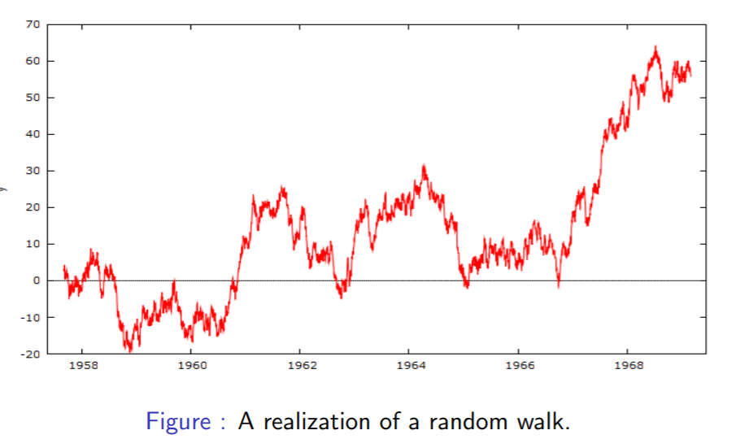
Examples (5)

Slide 24
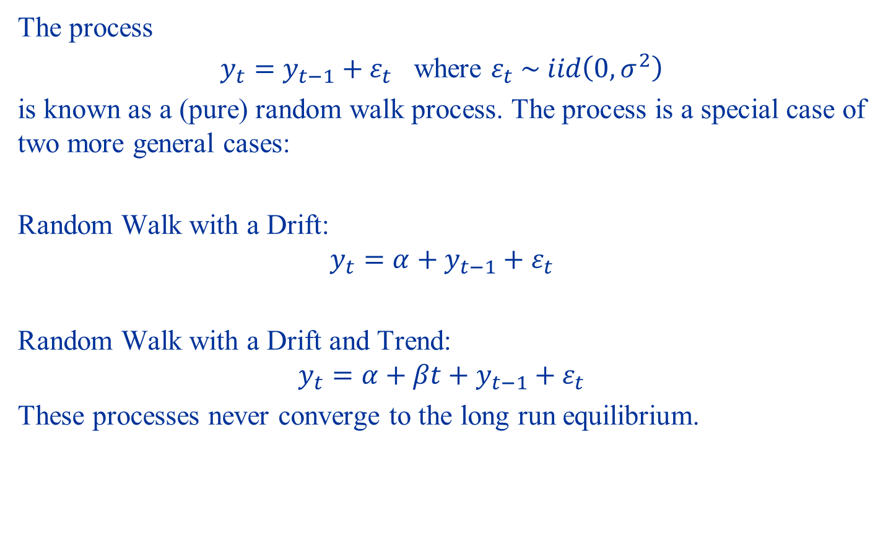
Examples (5)
The process
$y_{t}=y_{t−1}+ε_{t}$ where $ε_{t} \sim iid\left(0,σ^{2}\right)$
is known as a (pure) random walk process. The process is a special case of two more general cases:
Random Walk with a Drift:
$$y_{t}=α+y_{t−1}+ε_{t}$$
Random Walk with a Drift and Trend:
$$y_{t}=α+βt+y_{t−1}+ε_{t}$$
These processes never converge to the long run equilibrium.

Slide 25
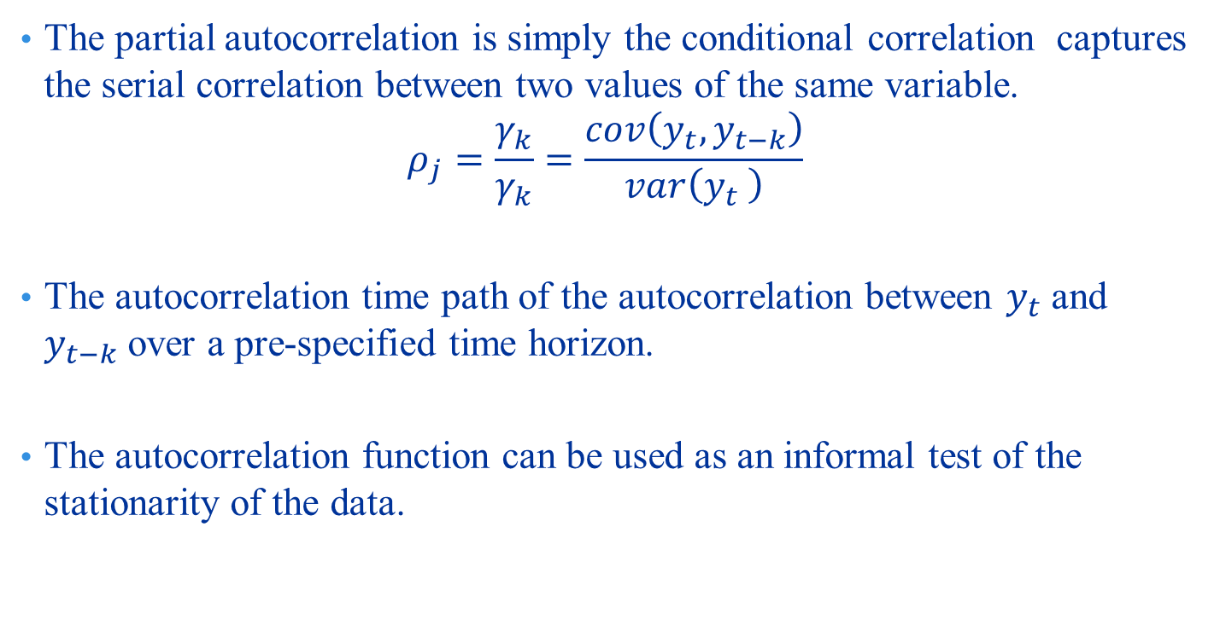
Autocorrelation and Partial Autocorrelation
The partial autocorrelation is simply the conditional correlation captures the serial correlation between two values of the same variable.
$$ρ_{j}=\frac{γ_{k}}{γ_{k}}=\frac{cov\left(y_{t},y_{t−k}\right)}{var\left(y_{t} \right)}$$
The autocorrelation time path of the autocorrelation between $y_{t}$ and $y_{t−k}$ over a pre-specified time horizon.
The autocorrelation function can be used as an informal test of the stationarity of the data.

Slide 26
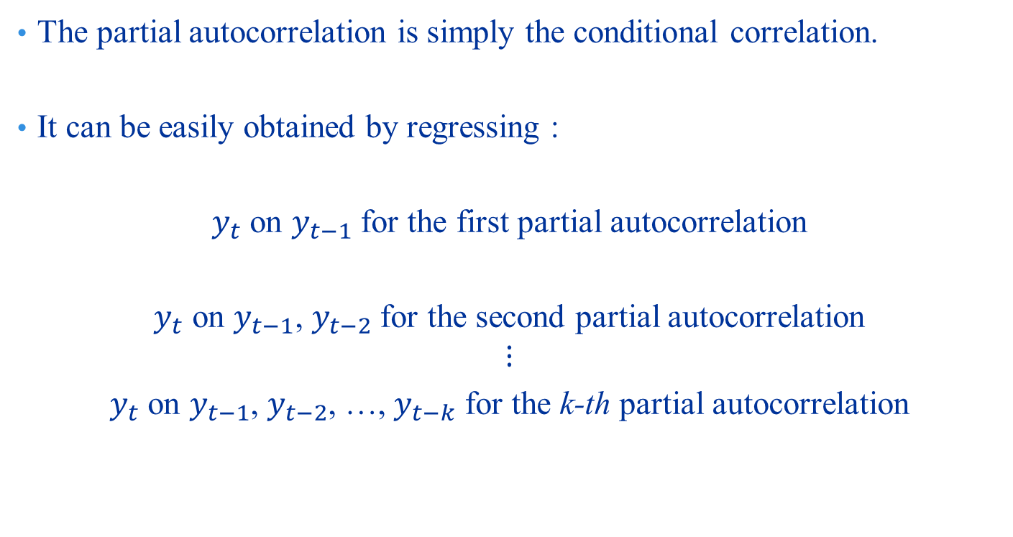
Autocorrelation and Partial Autocorrelation
The partial autocorrelation is simply the conditional correlation.
It can be easily obtained by regressing :
$y_{t}$ on $y_{t−1}$ for the first partial autocorrelation
$y_{t} \text{on} y_{t−1}\text{, }y_{t−2}$ for the second partial autocorrelation
$$⋮$$
$y_{t}$ on $y_{t−1}$, $y_{t−2}$, …, $y_{t−k}$ for the k-th partial autocorrelation

Slide 27
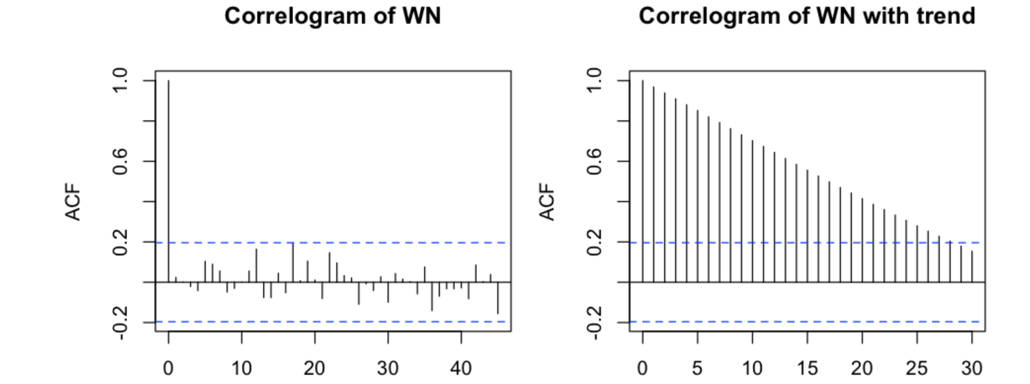
Autocorrelation and Partial Autocorrelation

Slide 28
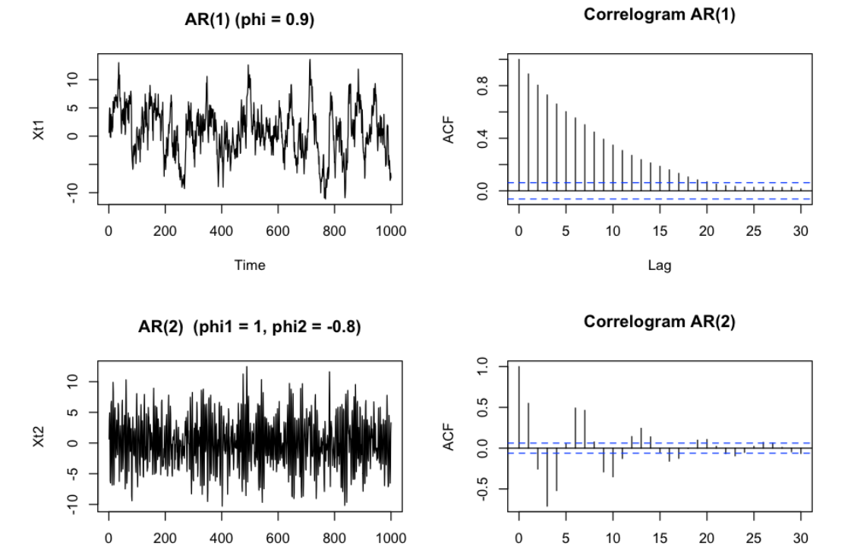
Autocorrelation and Partial Autocorrelation

Slide 29
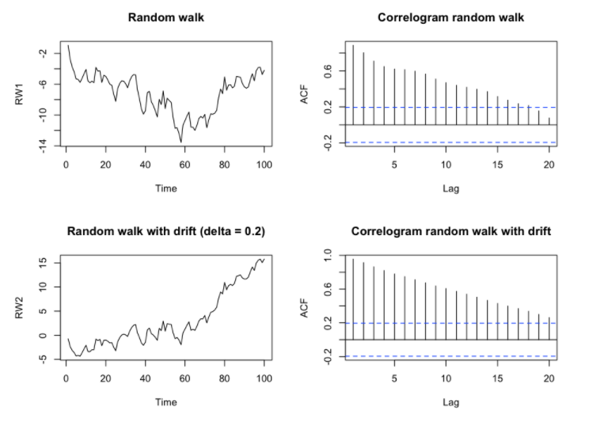
Autocorrelation and Partial Autocorrelation

Slide 30
Part II: ARIMA Models

Slide 31
ARMA Models: Assumptions
We employ two types of stationary processes
Strictly Stationary Process
Weakly (covariance) stationary process
1. E(y_{t}) = μ , t = 1,2,...,∞
2.
3. for any t₁ , t₂

Slide 32
Modelling Stationary Data
Dynamics of a single time series
Dependents on the data generating process
General properties include
Autoregressive behaviour
Moving average behaviour
Combination of the two
Others (not considered in this course)
Autoregressive Process
The model can be explained by its past values
The general form is called AR(p) model
The error term, u, is assumed to be iid with zero mean and constant variance

Slide 33
AR(1) Model
Remarks
The issue is choosing the lag length p
Many methods
Using information criteria
Using t statistics and significance of the lag
Using Box-Jenkins Method
AR(1)
The slope captures the effect of the past shock
For stationary data: 0<|φ₁|<1
The closer to 1: the longer the shock remains
The closer to 0: the faster the shock disappears

Slide 34
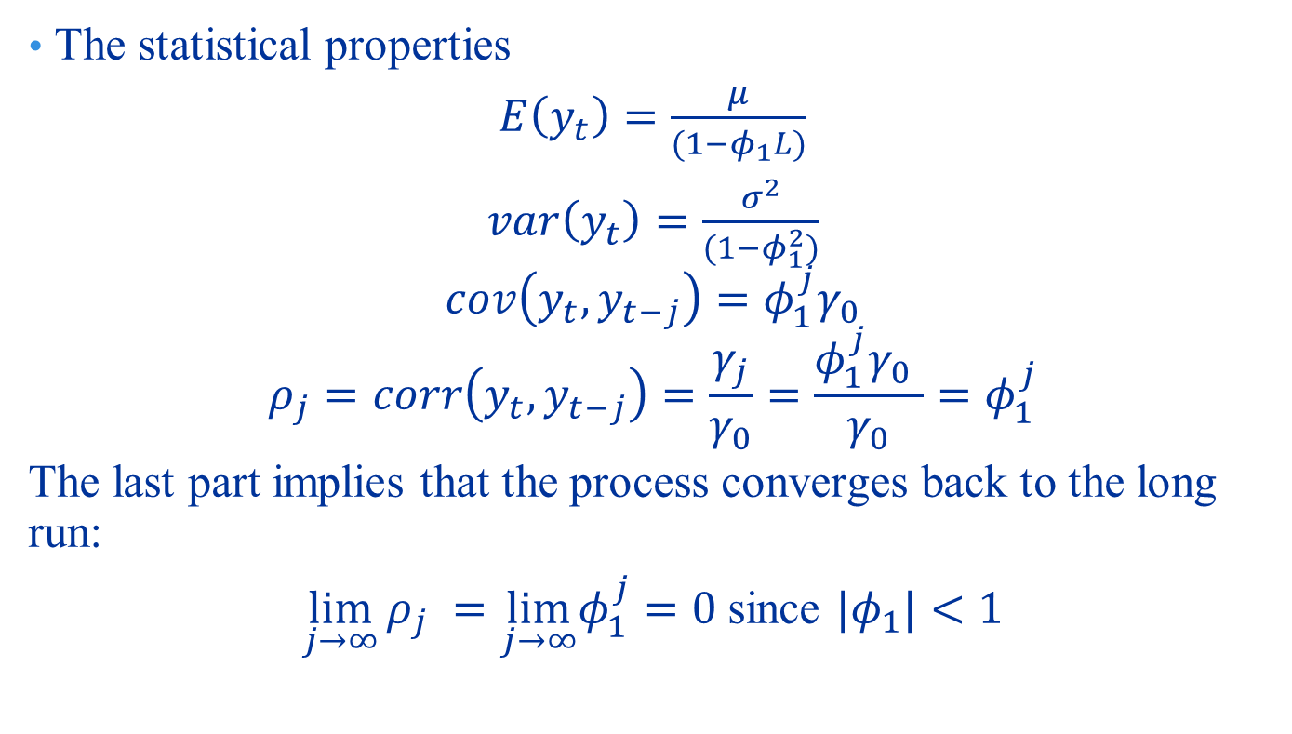
Properties of Stationary AR(1)
The statistical properties
$E\left(y_{t}\right)=\frac{μ}{(1−φ_{1}L)}$
$var\left(y_{t}\right)=\frac{σ^{2}}{(1−φ_{1}^{2})}$
$$cov\left(y_{t},y_{t−j}\right)={φ_{1}^{j}γ}_{0}$$
$$ρ_{j}=corr\left(y_{t},y_{t−j}\right)=\frac{γ_{j}}{γ_{0}}=\frac{{φ_{1}^{j}γ}_{0} }{γ_{0}}=φ_{1}^{j}$$
The last part implies that the process converges back to the long run:
$\lim_{j→∞}{ρ_{j}} =\lim_{j→∞}φ_{1}^{j}=0$ since ${|φ}_{1}|<1$

Slide 35
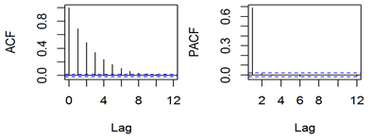
Properties of Stationary AR(1)

Slide 36
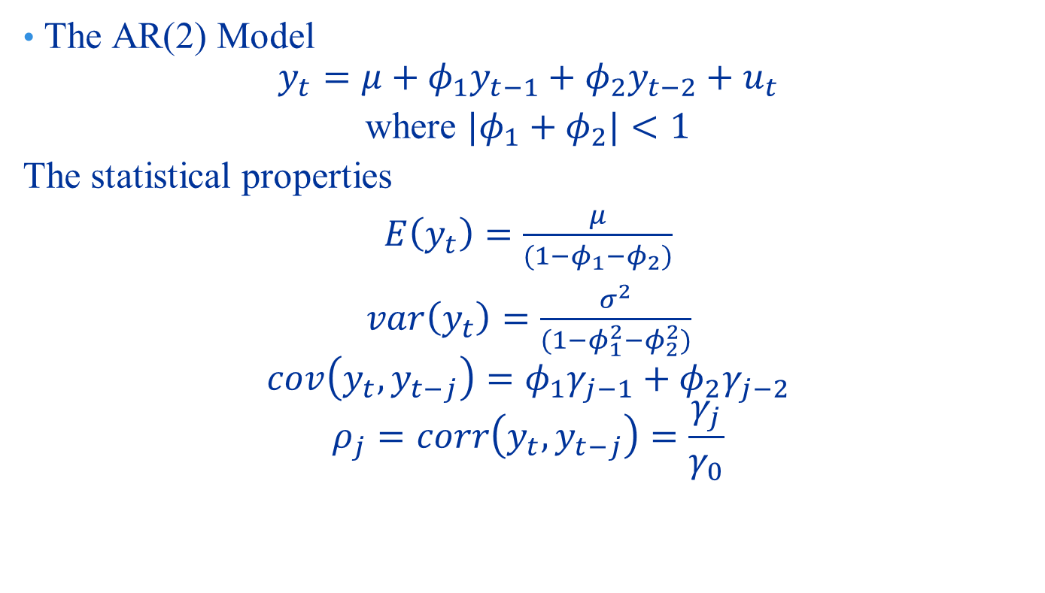
Properties of Stationary AR(2)
The AR(2) Model
$$y_{t}=μ+φ_{1}y_{t−1}+φ_{2}y_{t−2}+u_{t}$$
where ${|φ}_{1}+φ_{2}|<1$
The statistical properties
$E\left(y_{t}\right)=\frac{μ}{(1−φ_{1}−φ_{2})}$
$var\left(y_{t}\right)=\frac{σ^{2}}{(1−φ_{1}^{2}−φ_{2}^{2})}$
$$cov\left(y_{t},y_{t−j}\right)={φ_{1}γ}_{j−1}+{φ_{2}γ}_{j−2}$$
$$ρ_{j}=corr\left(y_{t},y_{t−j}\right)=\frac{γ_{j}}{γ_{0}}$$

Slide 37
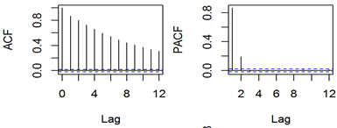
Properties of Stationary AR(2)

Slide 38
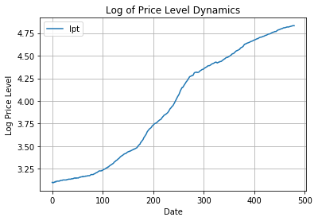
Example (1)
Consider the price level

Slide 39
Example (1)
Testing for the presence of stationarity:
Inspect the ACF.
Test whether the process is white noise using the Q statistic.
Confirm after estimation by inspecting the coefficients of the autoregressive process.
Inspecting the ACF
Choose the lag length (k-th): rule of thumb is to use quarter of the sample size. You can use less or more. The outcome is very sensitive to the lag length.
If the ACF dies off before the k-th lag, we conclude stationarity.
This test is informal. So you have to be careful.
See below

Slide 40
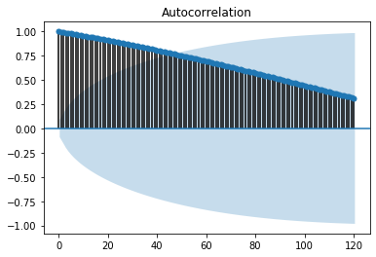
Example (1): k=120

Slide 41
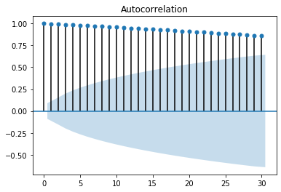
Example (1): k=30

Slide 42
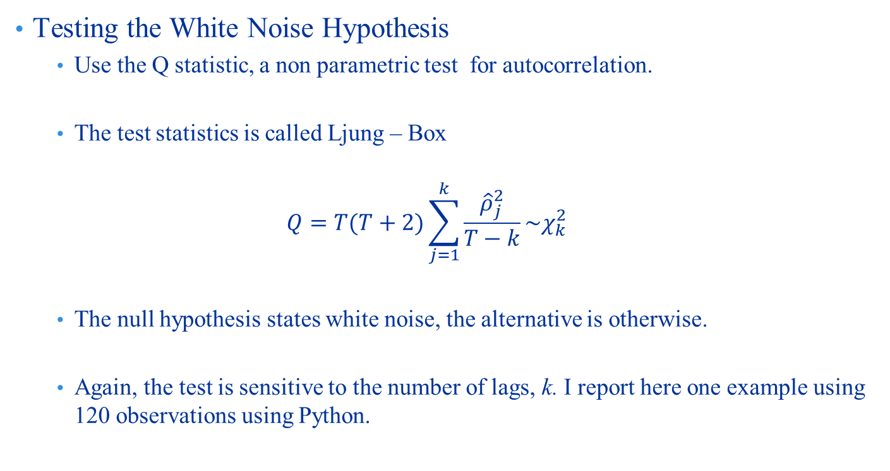
Example (1)
Testing the White Noise Hypothesis
Use the Q statistic, a non parametric test for autocorrelation.
The test statistics is called Ljung – Box
$$Q=T(T+2)\sum_{j=1}^{k}{\frac{{\hat{ρ}}_{j}^{2}}{T−k}\sim χ_{k}^{2}}$$
The null hypothesis states white noise, the alternative is otherwise.
Again, the test is sensitive to the number of lags, k. I report here one example using 120 observations using Python.

Slide 43
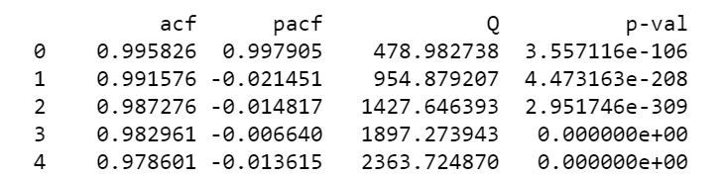
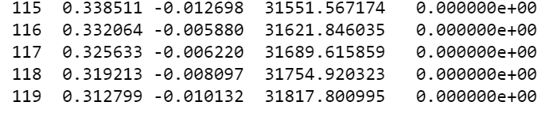
Example (1)

Slide 44
Example (1)
Determine the lag length:
Visual inspection: use PACF. The order of the AR is the same as the number of significant lags in the PACF.
It is not an easy to do so in practice.
Using Information Criteria: you may specify different models with different lag lengths and choose the model with the smallest information criterion.
Testing Down: use t statistic to choose the model with the highest significant lag length.
Determine the lag length:
Visual inspection: use PACF. The order of the AR is the same as the number of significant lags in the PACF.

Slide 45
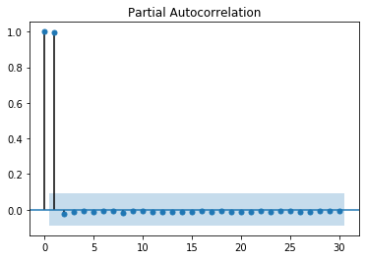
Example (1)

Slide 46
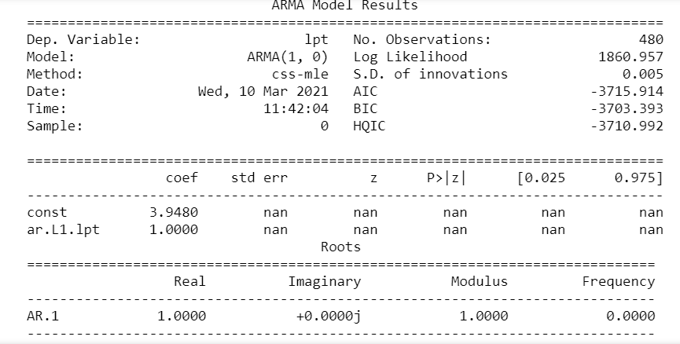
Example (1) – Estimating an AR(1) Model

Slide 47
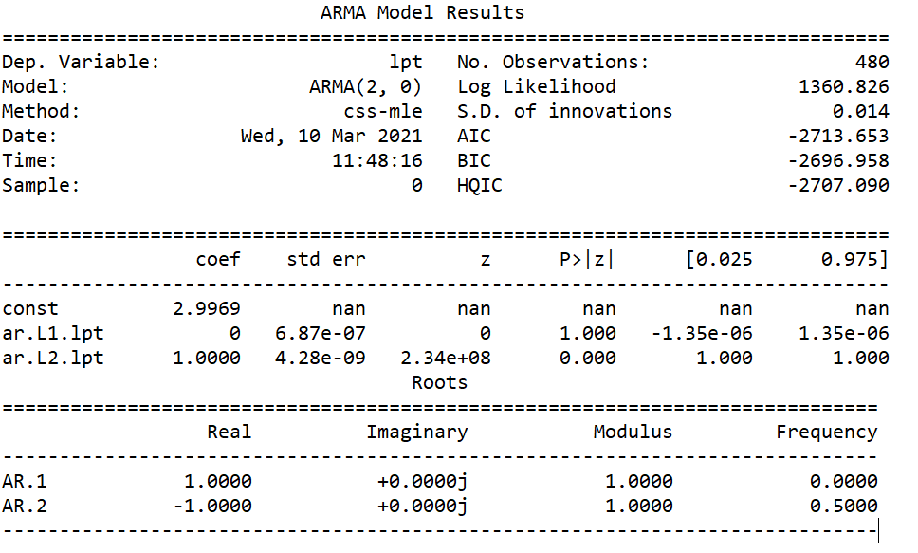
Example (1) – Estimating an AR(2) Model

Slide 48
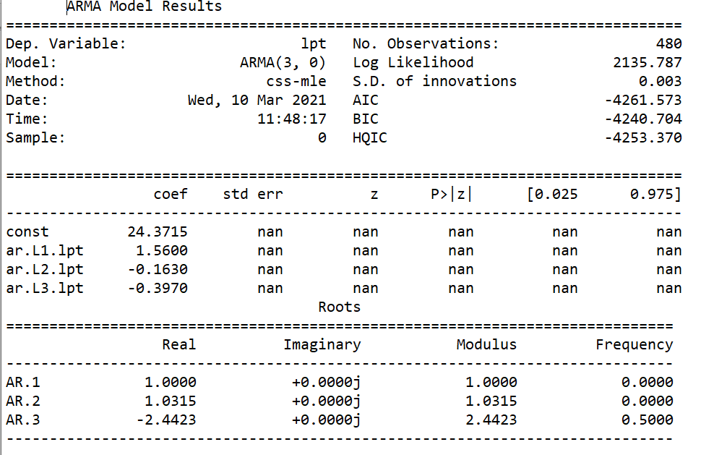
Example (1) – Estimating an AR(3) Model

Slide 49
Example (1)
Checking the unit circle
The coefficients of all the AR models. They are all near or equal to 1.
This means the process is not stationary.
The AR roots are outside the unit circle.
The solution
Take the first difference of the data to make it stationary.
The process becomes an ‘integrated process’.
If the process is stationary after the first difference, then it is called ‘integrated of order 1’.
The order of integration is equal to the number of times the first difference has been taken to make it stationary.
ARIMA: The ‘I’ in the acronym refers to the Integration, the order of integration.

Slide 50
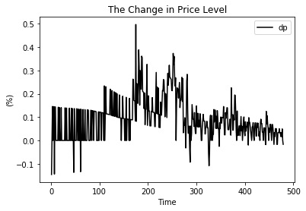
Example (1)

Slide 51
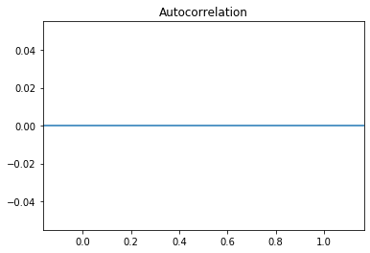
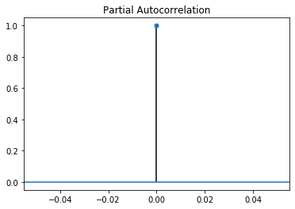
Example (1)

Slide 52
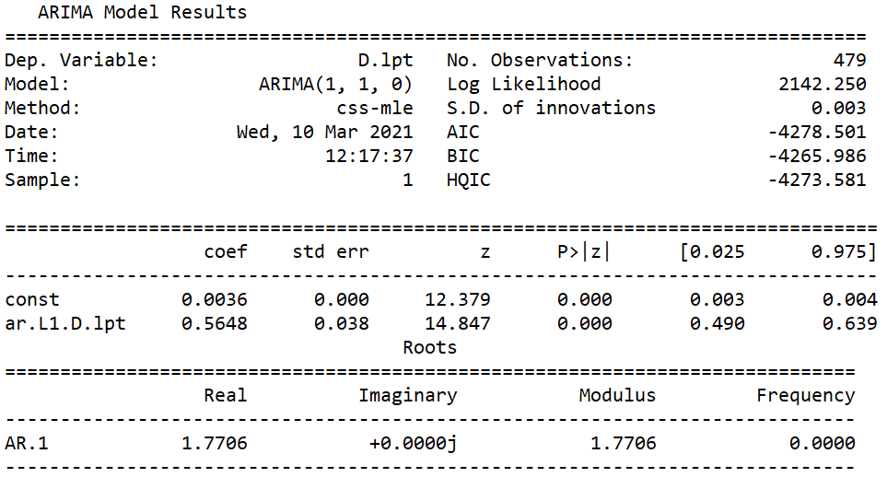
Example (1)

Slide 53
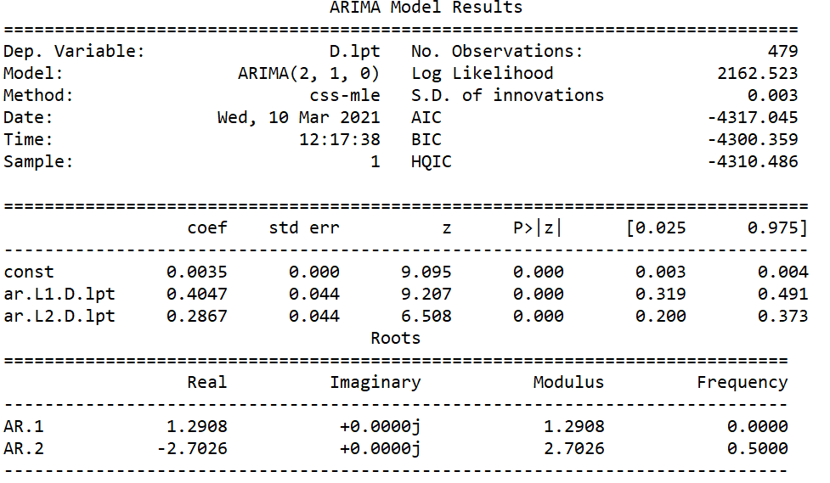
Example (1)

Slide 54
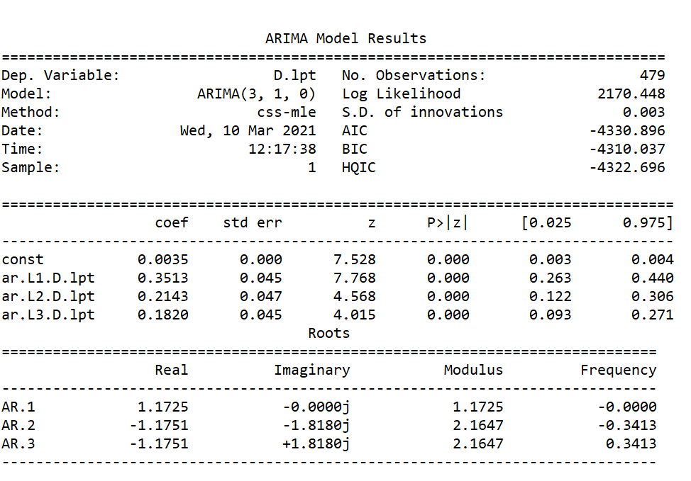
Example (1)

Slide 55
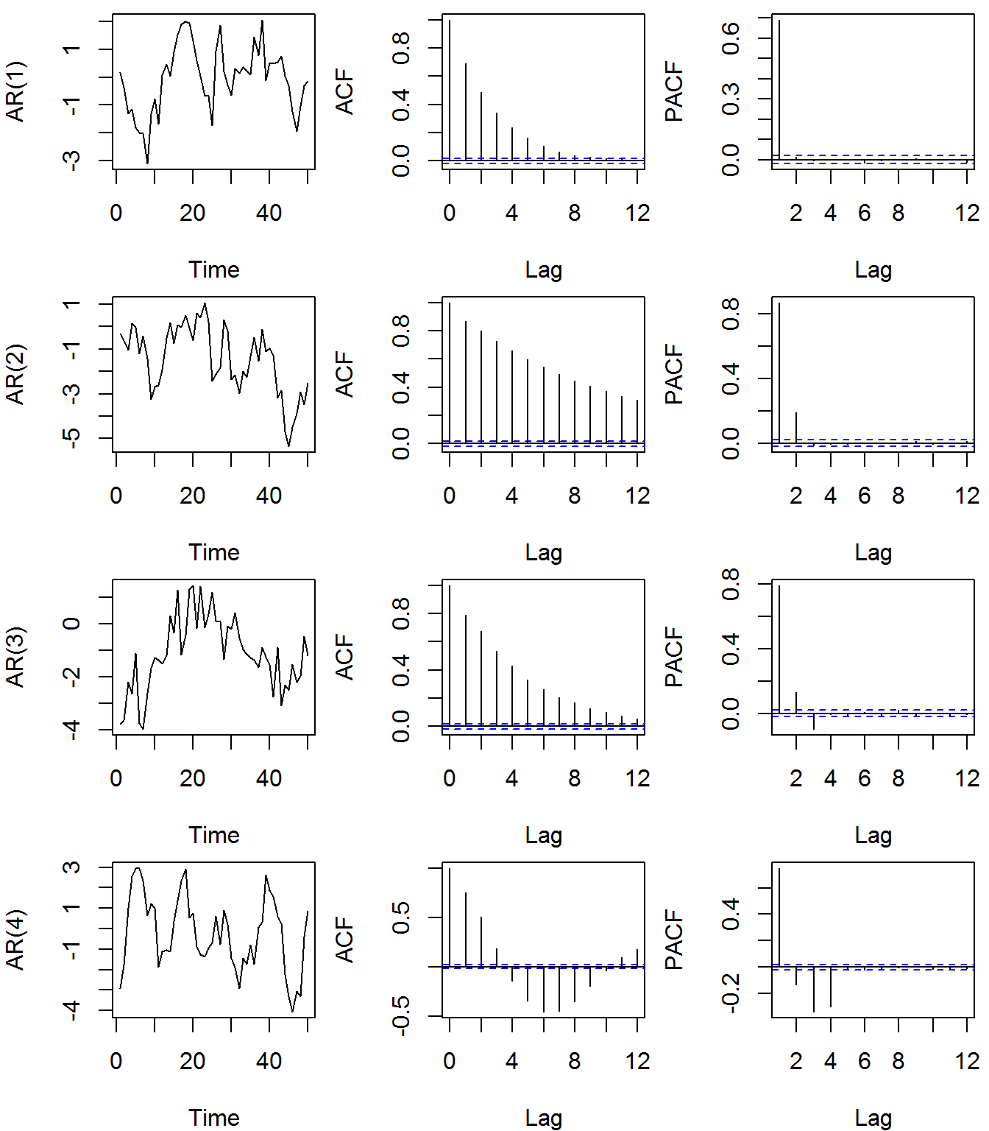
Properties of AR Process: ACF

Slide 56
Modelling Stationary Data
Moving Average, MA
The model can be explained by past and current unobserved shocks
The general form is called MA(q) model
The error term, u, is assumed to be iid with zero mean and constant variance.
y_{t} = μ + u_{t} + θ₁u_{t-1} + θ₂u_{t-2} + ... + θ_{q}u_{t-q}
MA(1)
y_{t} = μ + u_{t} + θ₁u_{t-1}
The choice of lags follows the same pattern as with AR process

Slide 57
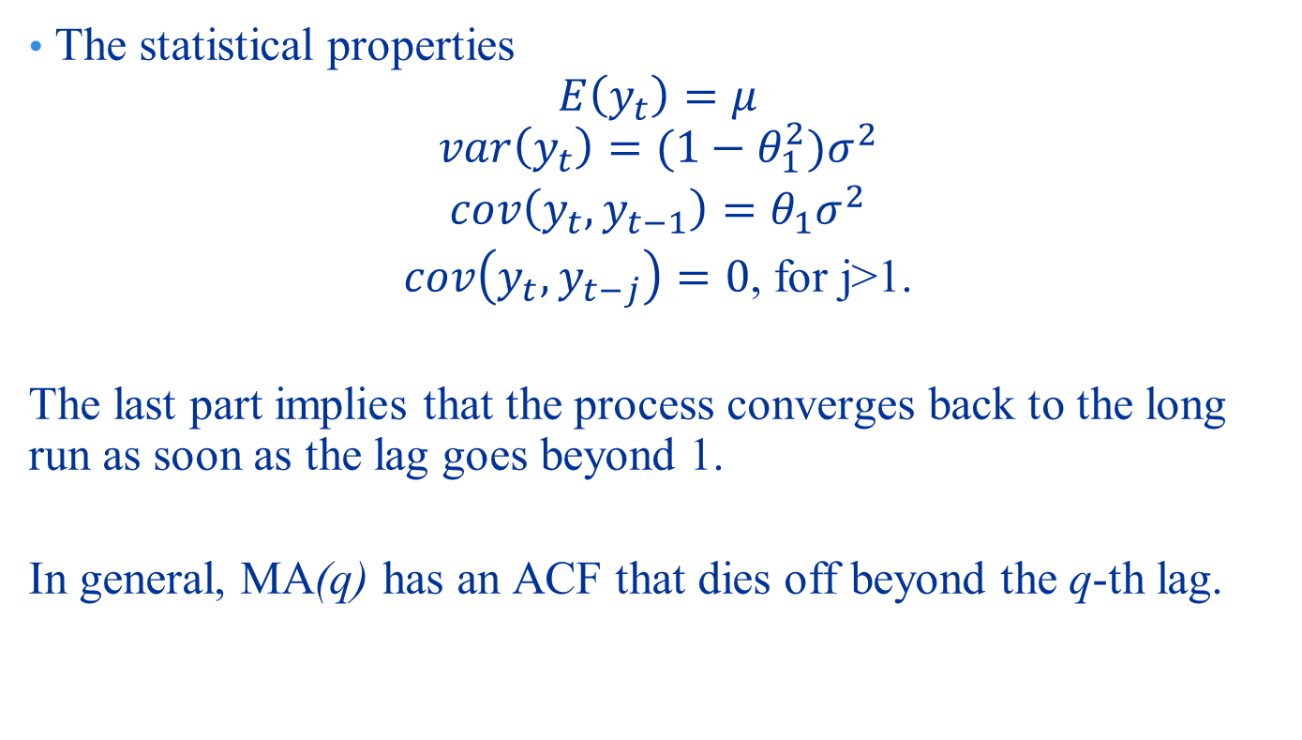
Properties of Stationary MA(1)
The statistical properties
$$E\left(y_{t}\right)=μ$$
$$var\left(y_{t}\right)=(1−θ_{1}^{2})σ^{2}$$
$cov\left(y_{t},y_{t−1}\right)=$ $θ_{1}σ^{2}$
$cov\left(y_{t},y_{t−j}\right)=0$, for j>1.
The last part implies that the process converges back to the long run as soon as the lag goes beyond 1.
In general, MA(q) has an ACF that dies off beyond the q-th lag.

Slide 58
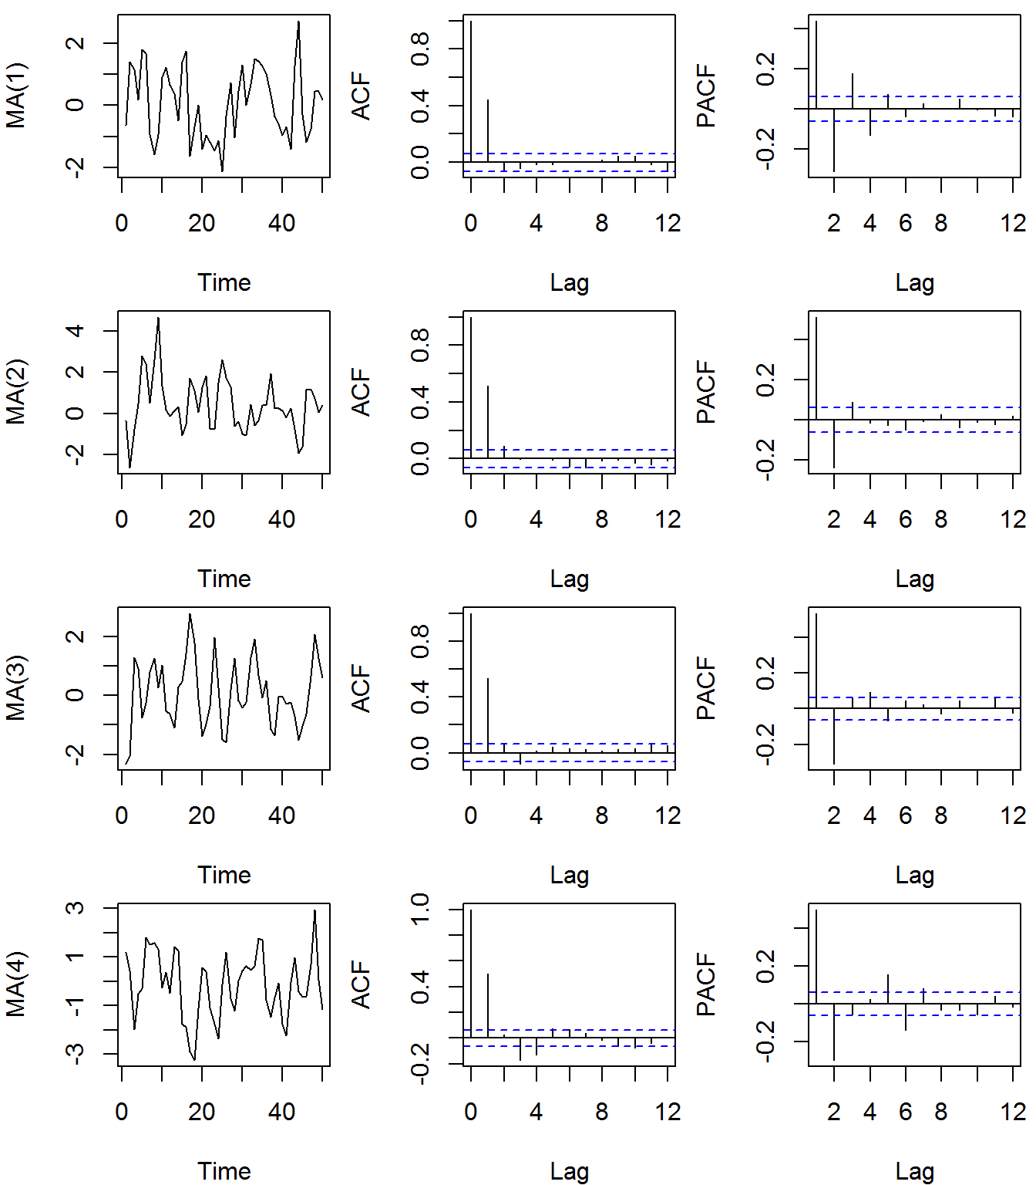
ACF of an MA Process

Slide 59
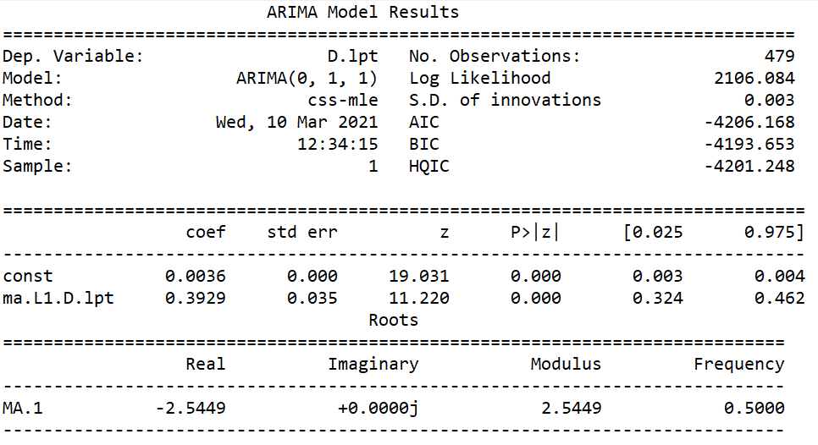
Example: MA(1)

Slide 60
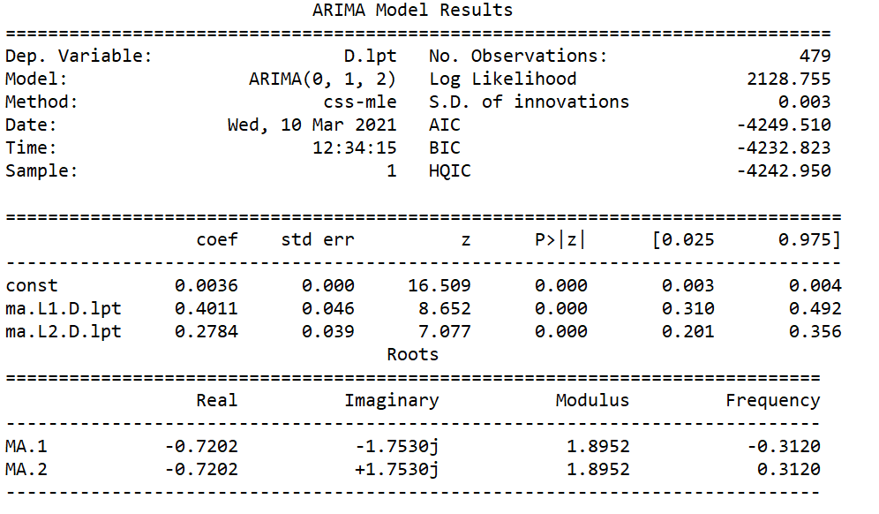
Example: MA(2)

Slide 61
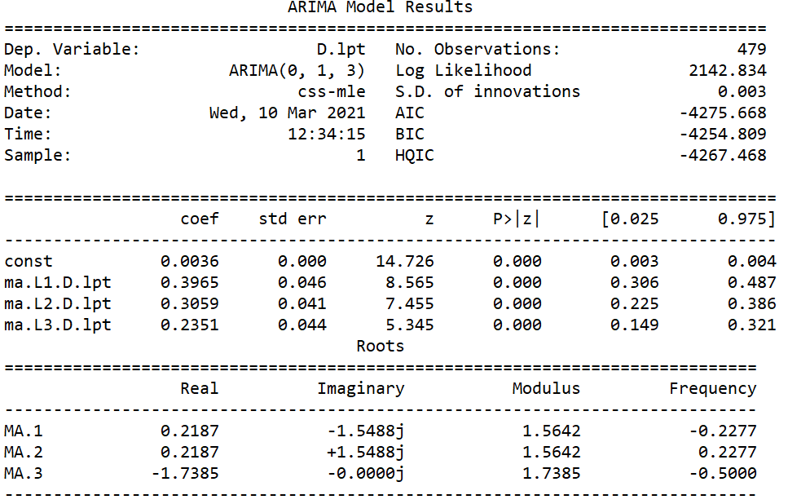
Example: MA(3)

Slide 62
ARIMA Models
Autoregressive Integrated Moving Average, ARIMA
The model can be explained by both AR and MA
The general form is called ARMA(p, q) model
The error term, u, is assumed to be iid with zero mean and constant variance.
ARMA(1,1)
y_{t} = μ + φ₁y_{t-1} + u_{t} + θ₁u_{t-1}
The choice of lags follows the same pattern as with AR and MA process

Slide 63
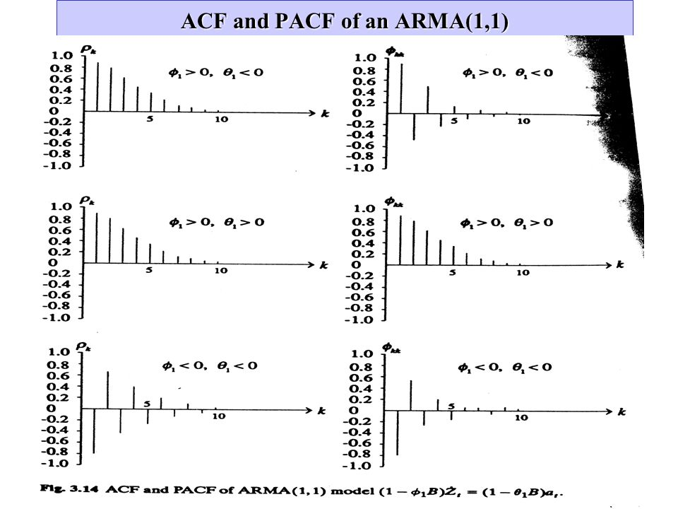
ACF of an ARMA Process

Slide 64
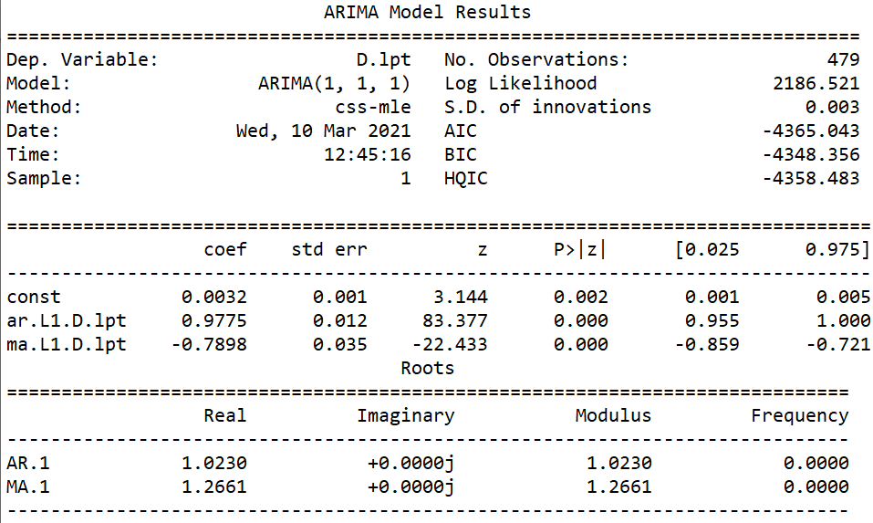
ARIMA(1,1,1) Regression Output

Slide 65
The Best Model?
So far, we estimated three models using differenced data.
This shows that the model should be defined as ARIMA and not as ARMA since the data in levels cannot be used (i.e. the time series is not stationary).
The natural questions now is which model of the seven ARIMA models is best to use?
We need a set of criteria to discriminate between all variables:

Slide 66
The Set of Criteria: Principles
Information Criteria: choose the model that produces the smallest information criteria.
The chosen model does not necessarily produce serially uncorrelated residuals.
White noise residuals: Once the model is chosen, residuals must be uncorrelated. If the model fails to produce white noise residuals, we choose the second best from the information criteria stage.
Parsimony Principle: In case two or models satisfy the second criterion, we choose the model with least number of parameters.

Slide 67
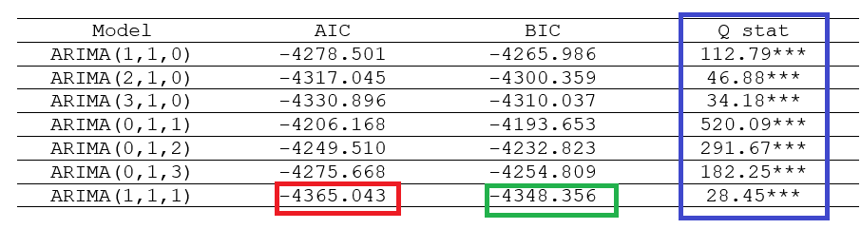
Example (3)

Slide 68
Box – Jenkins Methodology
It is an algorithm to aid analysing ARIMA models.
Now we bring together all the elements we learned so far to combine them into a set of steps to build the model that is best fit the data.
The purpose is forecasting. For forecasting, we require:
A parsimonious model
White noise residuals.

Slide 69
Box – Jenkins Methodology
Step 1: (Check for stationarity).
Use formal tests such as unit root tests (note: these will be covered in Week 11).
If data are not stationary, take the first difference till the data is stationary.
Determine the degree of integration, I.
Step 2: (Identification)
Use ACF and PACF to identify the ARIMA process.
Identify several models.
Step 3: (Estimation)
Save key statistics and verify significance of parameters.
Step 4: (Model Selection)
Use information criteria to select the lag length and the most suitable model.
Step 5: (Diagnostic Checking)
Check for white noise residuals. If the model does not produce a white noise residuals, go back to Step 2.
Step 6: (Forecasting)

Slide 70
THANK YOU

